Slide 1
Phase 1 analysis for a Manufacturing Process Control
ISEN 614 Advance Quality Control
Authors: Ayan Patel (UIN - 727004956)
Dhruvil Shah (UIN - 128001129)
Krisil Patel (UIN - 527003189)

Slide 2
Presentation Outline
Preliminary Analysis
Type of Process, Type of Data and Trend Analysis
Principal Component Analysis
Conversion of original data to principal components
Pareto and Scree plot to find components having maximum variance.
Control Charting
Use of T² and M-CUSUM. Iterations to remove out of control data points and generate an in control chart.
Find the in control Parameters i.e. µ₀ and Σ₀ .
Key Learnings

Slide 3
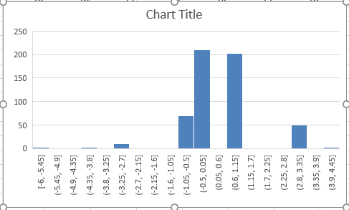
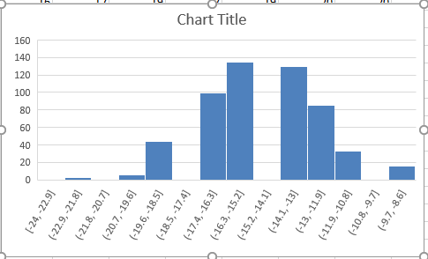
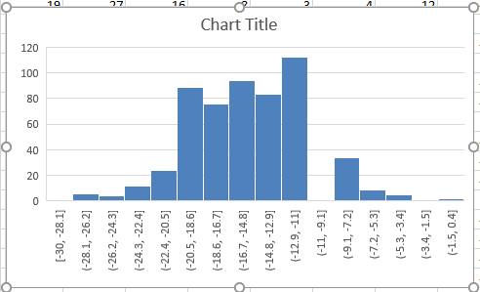
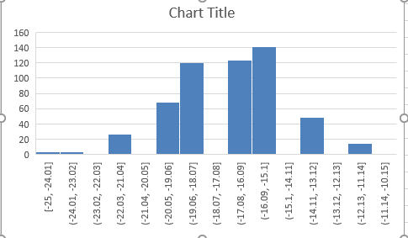
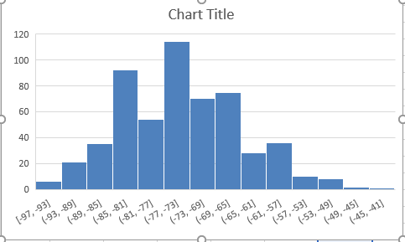
Preliminary Analysis.
We calculated the mean of each of the variables and plotted a graph from it.
We concluded that the process followed a unimodal trend having only one highest value.
We chose covariance matrix instead of correlation matrix in order to maintain original relationship between the variables of the process.
From the graph we assumed that the data follows normal distribution.
These Graphs shows that the data really follows a normal distribution and if we overlap them we can get a single normal distribution curve.

Slide 4
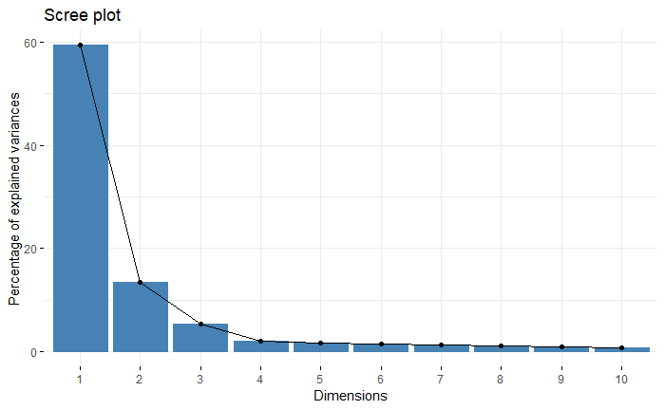
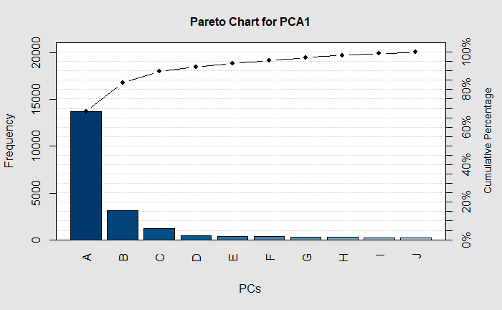
Principal Component Analysis.
R Code to find Eigen values and Eigen Vectors.
Using these Eigen values and Eigen vectors, we made Scree plot and Pareto plot.
Using Scree and Pareto Plot we reached to the result of using 4 PCs for the control chart
For scree Plot the elbow comes at 4 and so we selected PC=4
The result of scree plot was validated using Pareto analysis and found that I=4 contributed more than 90% of variance.

Slide 5
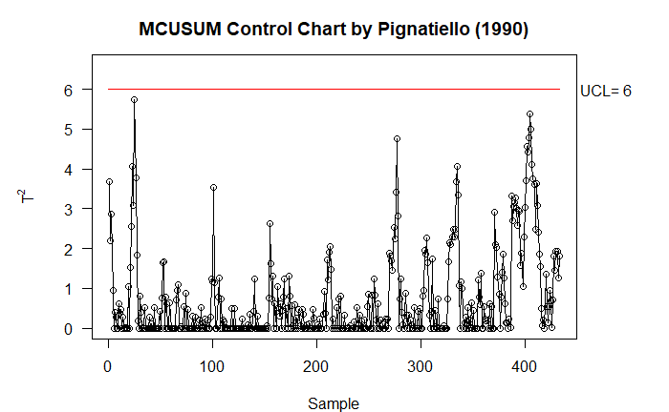
Control Charting
M- Cusum
We plot the Cusum chart.
We removed all the outliers/ Out of control samples.
We assumed mean shift of 3 and our desired ARL is 200.
For UCL we used Interpolation from p=2,3,10 to find value of p=4. We got UCL as 6.00 and ARL was 201.
Phase-I Analysis | Number of Out-of-Control Samples Observed
After the 1st iteration | 91
After the 2nd iteration | 23
After the 3rd iteration | 4
After the 4th iteration | 1
After the 5th iteration | 0
The table shows the number of iterations and the number of out of control points. We had 6 iterations after which we go all the data points in control. We used R programming to do those iterations.
The data points seem in control for the M_CUSUM chart however we can not say that all the data points are in control based on only CUSUM chart. We need T² Chart too for determining the in control data points.

Slide 6
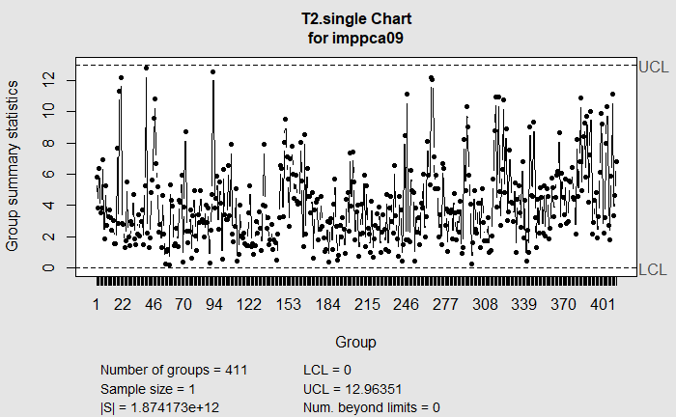
Control Charting
Hotelling T² Control Chart
As every variable from 0 to 209 have unique observational value, n=1
The number of PCA used, p=4.
The sigma limit used is similar to Shewhart control chart with 3 Sigma. Control limit Therefore α = 0.0027 and using these parameters and Chi Square table we calculated UCL of ~13.
We then plotted the in control M-CUSUM chart data points in T² chart.
Phase-I Analysis | Number of Out-of-Control Samples Observed
After the 1st iteration | 11
After the 2nd iteration | 4
After the 3rd iteration | 5
After the 4th iteration | 2
After the 5th iteration | 0
The table shows the number of iterations and the number of out of control points. We had 5 iterations after which we go all the data points in control. We used R programming to do those iterations.
After the iterations the chart seems in control for T² and we already removed outliers for M-Cusum chart. However we run M-CUSUM chart once again so that we can be sure of the result.

Slide 7
Control Charting
We run M-CUSUM chart again and ensure that data points are in control. When we run the M-CUSUM chart we get 3 data points out of control.
So we do phase one again and after 1 iteration, there were Zero out of control data points.
With these data we ran T2 chart again and there were no out of control data points. This concluded that 408 out of 552 samples were in control and didn’t had any spike change or mean shift.
This data points can be used as control chart for future observations.
The final data points we obtained are 408 out of 552 samples. These can be used to plot a chart with α = 0.0027 for Hotelling T2 chart and sustained mean shift of 3 for M-CUSUM chart.
Using M-Cusum chart we removed 91, 23, 4 and 1 i.e. 119 samples. So the remaining samples are 433 samples from which we removed 11,4,5 and 2 i.e. 22 samples using Hotelling T² chart. The remaining samples were 411. From these 411 samples we again removed 3 samples using T² hoteling resulting in 408 samples having no mean shift or spike changes.

Slide 8
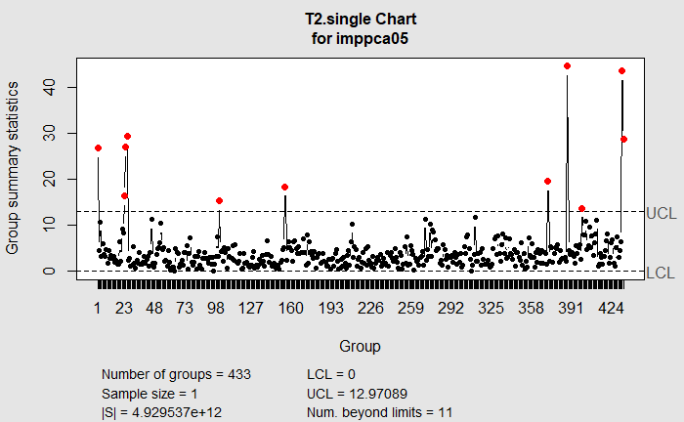
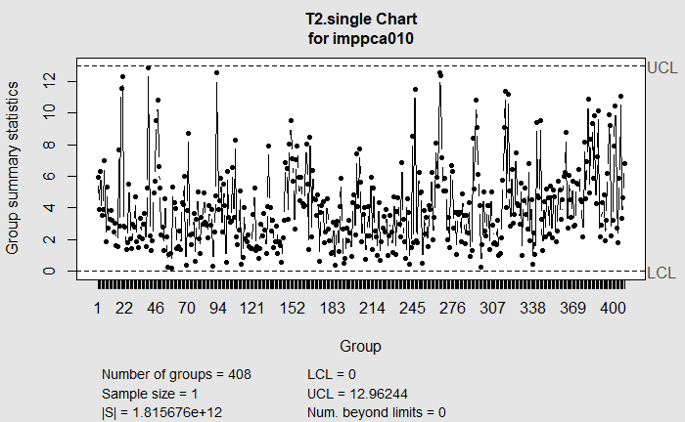
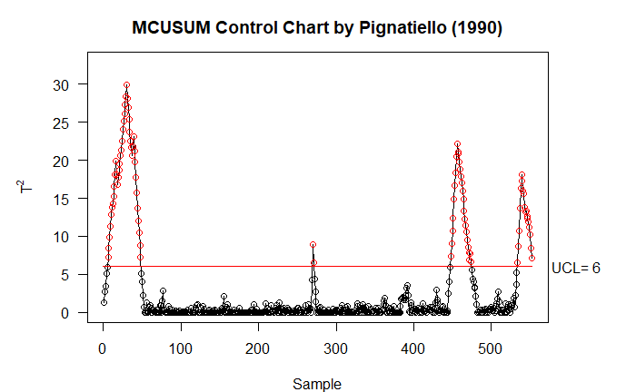
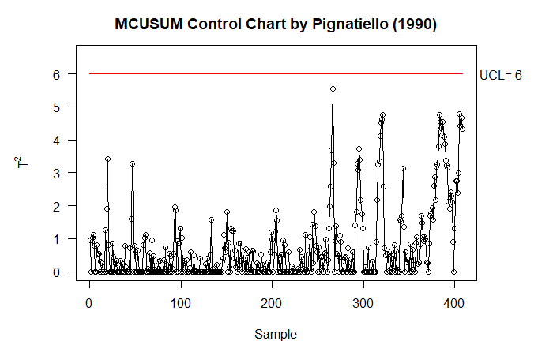

Slide 9
Key learnings
Using multiple Univariate control chart for large dimensional data can create a lot of errors but they can help in understanding the nature of variables.
Using only T² control chart or M-Cusum control chart can be problematic. As seen in this project when M-Cusum was in control there were still some of the out of control data points present that were out of control detected by T².
The order of using the chart is also important. It matters if we use T² first or M-Cusum in terms of number of iterations required. We should use M-Cusum before T² can reduce the number of required iterations.
We should check for the out of control points for other method even if one method is in in control as observed when M-Cusum was in control but T² still had out of control data points.
We used interpolation because PCS were less than 10 but if they were more we could not have solved the project because we can not extrapolate.
The use of MDL, Scree Plot and Pareto can drastically reduce the number of PCA’s.
A lot of small variables can create noise in the system and that should be kept in mind while designing a control chart.

